Slide 1



INSTITUTE: UIE (AIT-CSE)
CSS21: B.E. CSE (H) with specialization in Artificial Intelligence & Machine Learning
Advanced Machine Learning (20CSF-349)
Chapter 1.1: Linear Regression
Lecture 1 & 2: Simple Linear Regression & Regression Line
By: Mr. Siddharth Kumar
DISCOVER . LEARN . EMPOWER

Slide 2
Advanced Machine Learning
Course Outcome
CO | Title
1 | Have a good understanding of the fundamental issues and challenges of machine learning: data, model selection, model complexity, etc.
2 | Appreciate the underlying mathematical relationships within and across Machine Learning algorithms and the paradigms of supervised and un-supervised learning
3 | Design and implement various machine learning algorithms in a range of real-world applications.
4 | Design and evaluate intelligent expert models for perception and prediction using machine learning algorithms
5 | Analyze and make use of machine learning algorithms-based applications using performance

Slide 3
What is Linear Regression?
Linear regression is one of the easiest and most popular Machine Learning algorithms. It is a statistical method that is used for predictive analysis. Linear regression makes predictions for continuous/real or numeric variables such as sales, salary, age, product price, etc.
Linear regression algorithm shows a linear relationship between a dependent (y) and one or more independent (y) variables, hence called as linear regression. Since linear regression shows the linear relationship, which means it finds how the value of the dependent variable is changing according to the value of the independent variable.
The linear regression model provides a sloped straight line representing the relationship between the variables.
Mathematically, we can represent a linear regression as:
y= a0+a1x+ ε

Slide 4
Here, Y= Dependent Variable (Target Variable)
X= Independent Variable (predictor Variable)
a0= intercept of the line (Gives an additional degree of freedom)
a1 = Linear regression coefficient (scale factor to each input value).
ε = random error
The values for x and y variables are training datasets for Linear Regression model representation.
Types of Linear Regression: Linear regression can be further divided into two types of the algorithm:
Simple Linear Regression: If a single independent variable is used to predict the value of a numerical dependent variable, then such a Linear Regression algorithm is called Simple Linear Regression.
Multiple Linear regression: If more than one independent variable is used to predict the value of a numerical dependent variable, then such a Linear Regression algorithm is called Multiple Linear Regression.

Slide 5
What is Simple Linear Regression?
Regression models describe the relationship between variables by fitting a line to the observed data. Linear regression models use a straight line, while logistic and nonlinear regression models use a curved line. Regression allows you to estimate how a dependent variable changes as the independent variable(s) change.
Simple linear regression is used to estimate the relationship between two quantitative variables. You can use simple linear regression when you want to know:
How strong the relationship is between two variables (e.g. the relationship between rainfall and soil erosion).
The value of the dependent variable at a certain value of the independent variable (e.g. the amount of soil erosion at a certain level of rainfall).
Note: If you have more than one independent variable, use multiple linear regression instead.

Slide 6
Assumptions of Simple Linear Regression
Simple linear regression is a parametric test, meaning that it makes certain assumptions about the data. These assumptions are:
Homogeneity of variance (homoscedasticity): the size of the error in our prediction doesn’t change significantly across the values of the independent variable.
Independence of observations: the observations in the dataset were collected using statistically valid sampling methods, and there are no hidden relationships among observations.
Normality: The data follows a normal distribution.
Linear regression makes one additional assumption:
4. The relationship between the independent and dependent variable is linear: the line of best fit through the data points is a straight line (rather than a curve or some sort of grouping factor).
If your data do not meet the assumptions of homoscedasticity or normality, you may be able to use a nonparametric test instead, such as the Spearman rank test.

Slide 7
How to perform a Simple Linear Regression
The formula for a simple linear regression is:
y is the predicted value of the dependent variable (y) for any given value of the independent variable (x).
B0 is the intercept, the predicted value of y when the x is 0.
B1 is the regression coefficient – how much we expect y to change as x increases.
x is the independent variable ( the variable we expect is influencing y).
e is the error of the estimate, or how much variation there is in our estimate of the regression coefficient.
Linear regression finds the line of best fit line through your data by searching for the regression coefficient (B₁) that minimizes the total error (e) of the model.

Slide 8
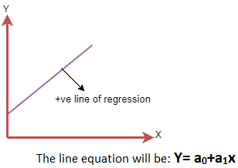
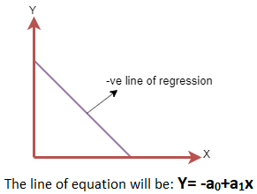
What is Regression Line?
A regression line is a line which is used to describe the behavior of a set of data. In other words, it gives the best trend of the given data. In this article, we will learn more about Regression lines and why it is important.
In other words, a line showing the relationship between the dependent and independent variables is called a regression line. A regression line can show two types of relationship:
Positive Linear Relationship: If the dependent variable increases on the Y-axis and independent variable increases on X-axis, then such a relationship is termed as a Positive linear relationship.
Negative Linear Relationship: If the dependent variable decreases on the Y-axis and independent variable increases on the X-axis, then such a relationship is called a negative linear relationship.

Slide 9

Finding the Best Fit Line
When working with linear regression, our main goal is to find the best fit line that means the error between predicted values and actual values should be minimized. The best fit line will have the least error.
The different values for weights or the coefficient of lines (a0, a1) gives a different line of regression, so we need to calculate the best values for a0 and a1 to find the best fit line, so to calculate this we use cost function.
For Linear Regression, we use the Mean Squared Error (MSE) cost function, which is the average of squared error occurred between the predicted values and actual values. It can be written as:
Where, N=Total number of observation
Yi = Actual value
(a1xi+a0)= Predicted value

Slide 10
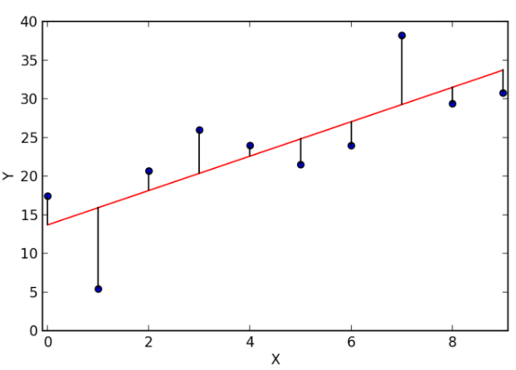
Why Regression Lines are important?
Regression lines are useful in forecasting procedures. Its purpose is to describe the interrelation of the dependent variable(y variable) with one or many independent variables(x variable).
Using the equation obtained from the regression line acts as an analyst who can forecast future behaviors of the dependent variables by inputting different values for the independent ones.
Regression lines are used in the financial sector and in business. Various financial analyst employs linear regressions to forecast stock prices, commodity prices and to perform valuations for many different securities. Various companies employ linear regressions for the purpose of forecasting sales, inventories, and many other variables.
Regression Line

Slide 11
Some Important Properties of the Regression Line
Regression coefficients values remain the same. Since shifting of origin takes place because of the change of scale.
If there are two lines of regression. Both of these lines intersect at a specific point [x’, y’]. Variables x and y are taken into consideration. According to the property, the intersection of both the lines of regression i.e. y on x and y is [x’, y’]. This is the solution for both of the equations of variables x and y.
You will find the correlation coefficient between the two variables x and y is the geometric mean of both the coefficients. Also, the sign over the values of correlation coefficients will be the common sign of both the coefficients. So, if according to the property regression coefficients are b_{yx}= (b) and b_{xy}= (b’) then the correlation coefficient is r=+-sqrt (b_{yx} + b_{xy}) so, in some cases, both the coefficients give a negative value and r is also negative. If both the values of coefficients are positive the r will be positive.
The regression constant (a₀) is equal to the y-intercept of the regression line. Where a₀ and a₁ are the regression parameters.

Slide 12
References
T1: Mitchell T.M., Machine Learning, McGraw Hill (1997).
T2: Andreas C. Miller, Sarah Guido, Introduction to Machine Learning with Python, O’REILLY (2001).
Notes:
Introduction to Cyber Security (simplilearn.com)

Slide 13

THANK YOU

